Slide 1

Let us begin writing our C.V.
China
Ireland
Name
[email address][phone number] [WeChat ID]
Personal Information
Gender
Date of Birth
Nationality
Personal statement
Brief summary of your research interests which is tailored to the job you are applying for
Education
PhD [field of study] [university][completion date]
MSc [field of study] [university][completion date]
BSc [field of study] [university][completion date]
School results [field of study] [school][completion date] [result]
Name
[email address][phone number] [linkedin profile]
Personal statement
Brief summary of your research interests which is tailored to the job you are applying for
Education
PhD [field of study] [university][completion date]
MSc [field of study] [university][completion date]
BSc [field of study] [university][completion date]
School results [field of study] [school][completion date] [result]

Slide 2
Let us begin writing our C.V.
China
Ireland
Research Experience
Postdoctoral researcher [institution][Year present][Description of the research focus]
Research Assistant[institution][Year present][Description of the research focus]
Publications
Conferences and Presentations
[Presentation Title] [Name of the Conference][Date][Location]
Awards and Grants
Teaching Experience
Teaching Assistant [Course name] [University Name][Year] [Description of responsibilities]
Skills
Volunteering Experience
Professional Membership

Slide 3
Key Differences
Personal information: In China it is included. In Ireland, this is not included
Language: In China, the C.V. can be written in Chinese or English depending on the context. In Ireland, it is written in English.
Research Goal: In China it is common to include a section outlining your research goals or objectives. This is not always present in Ireland
Format and Structure: In China, C.V.s are more rigid and formal.

Slide 4
Formatting
Font size 12 and be consistent
Always send in PDF.
No longer than 2-3 pages
Avoid large blocks of text
Bold to emphasis important aspects of your C.V.

Slide 5
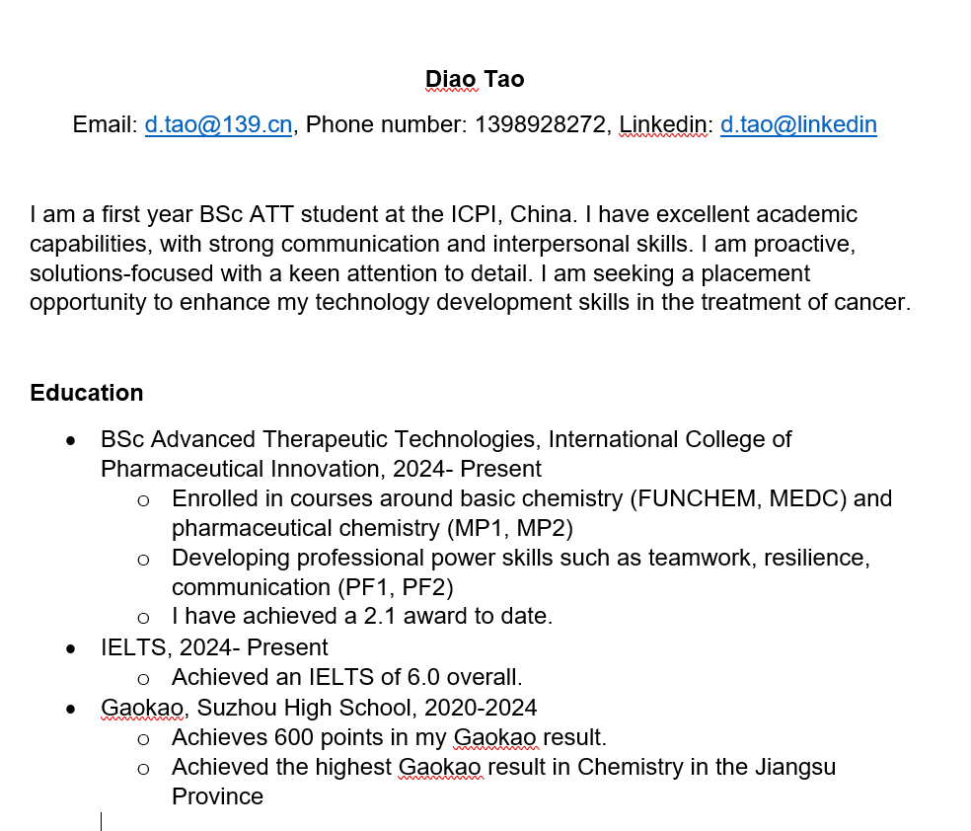
Let us begin writing our C.V.
Ireland
Name
[email address][phone number] [linkedin profile]
Personal statement
Brief summary of your research interests which is tailored to the job you are applying for
Education
PhD [field of study] [university][completion date]
MSc [field of study] [university][completion date]
BSc [field of study] [university][completion date]
School results [field of study] [school][completion date] [result]

Slide 6
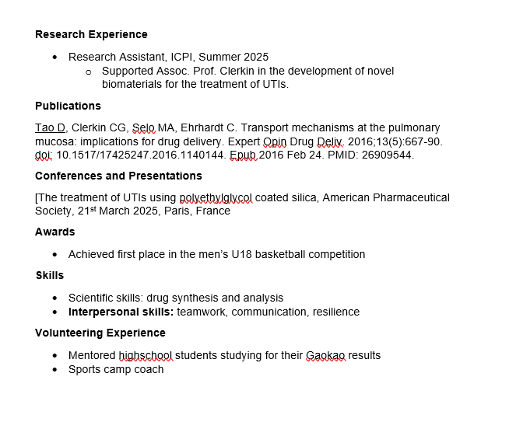
Let us begin writing our C.V.
Ireland
Research Experience
Postdoctoral researcher [institution][Year present][Description of the research focus]
Research Assistant[institution][Year present][Description of the research focus]
Publications
Conferences and Presentations
[Presentation Title] [Name of the Conference][Date][Location]
Awards and Grants
Teaching Experience
Teaching Assistant [Course name] [University Name][Year] [Description of responsibilities]
Skills
Volunteering Experience
Professional Membership

Slide 7
Note
There will be sections of your C.V. that you will not be able to write. This is ok and is not expected that you have every section completed at this stage in your scientific journey.
For now it is important to focus on your degree, professional skill development, volunteering experience.
To improve your C.V., try to
Gain experience working in the research lab of your teachers
Volunteer
Achieve the highest result in your exams
Seek out any opportunity

Slide 8
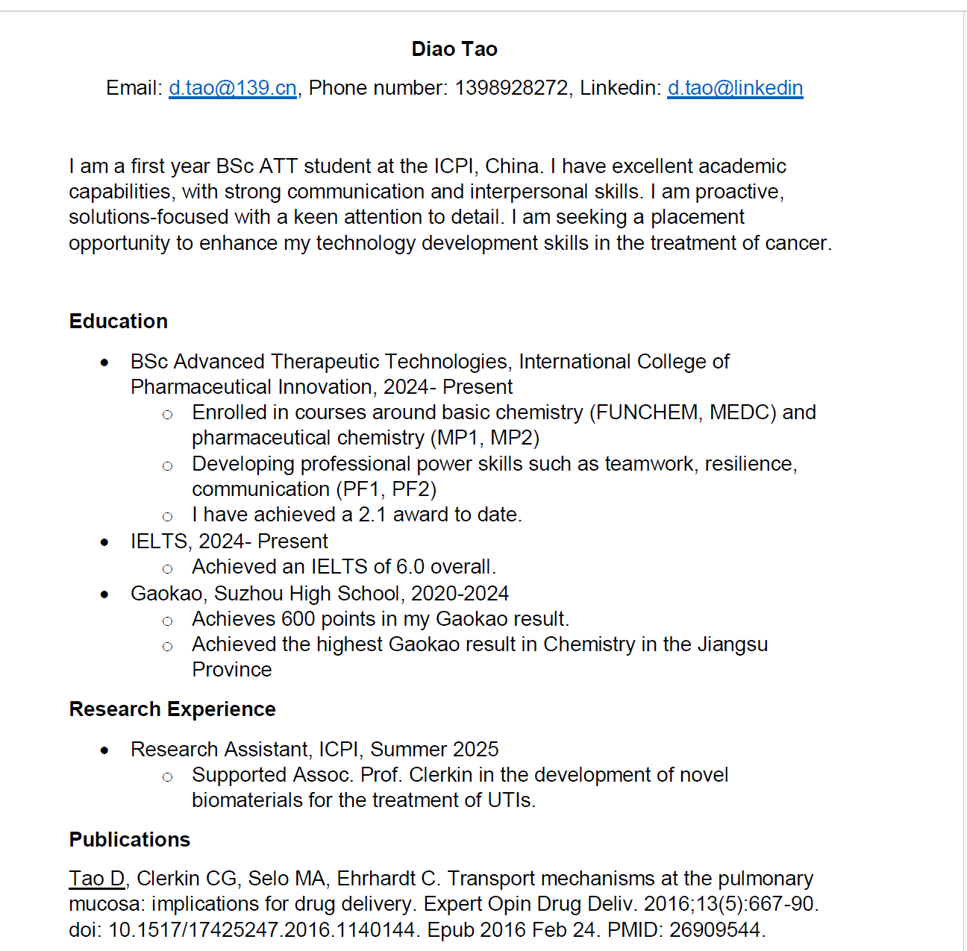
This is a perfectly fine C.V. but it doesn’t look too interesting. It is a bit boring

Slide 9
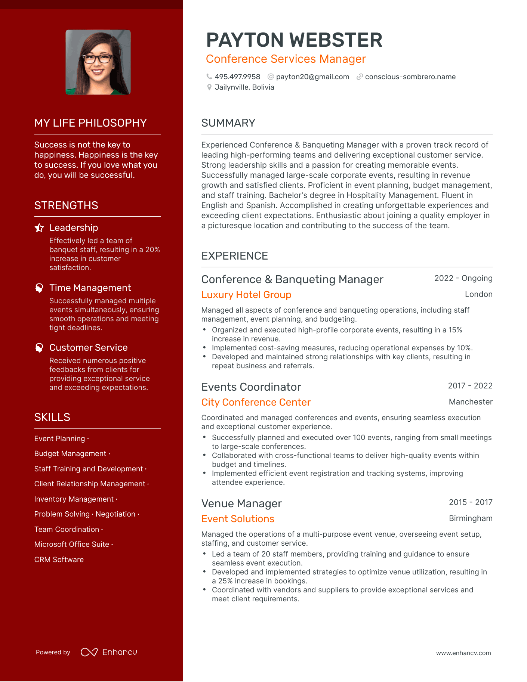
The use of colour
Highlights to the reader her overall strengths and skills

Slide 10
What do employers want to see?

Slide 11
Can you write your C.V?

Slide 12

Linkedin Profiles
Once your C.V. is complete you can copy this information across to your linkedin profile
https://www.linkedin.cn/incareer/home
You may need a VPN to access this site.

Slide 13
What is Linkedin?
LinkedIn is a professional networking platform.
It allows users to connect with colleagues, search for jobs, and share professional content.
LinkedIn features include:
- Profile creation
- Networking
- Job searching
- Content sharing

Slide 14
What is Linkedin?
A strong online persona helps in:
- Establishing credibility
- Networking with professionals
- Enhancing career opportunities
Showcasing skills and achievements
Tips for building a strong online persona:
- Keep your profile updated
- Share relevant content
- Engage with your network

Slide 15
What is Linkedin?
Privacy and professionalism are crucial in the digital age.
Key points to consider:
- Protect your personal information
- Be mindful of what you share online
- Maintain a professional tone in communications
- Understand privacy settings on platforms like LinkedIn

Slide 16
Cover letter
When applying for jobs or placements, often you will be requested to complete a cover letter for the role.
A cover letter should
Grab the readers attention
Be clear and concise
Free from typos/grammatical errors
Contain relevant information
Be targeted

Slide 17
Cover letter
Introduction: Dear panel members
What can you offer: I wish to apply for the position of the student placement as I have the key skills required for an ATT scientist and would like to gain industrial experience
Why do you want to work with the company: I would like to work with Pfizer as I believe this company is….
Why this role: This role interests be because….
Other information that will support you in the role: I have necessary skills to undergo a student placement. For example, during my time as an ATT student, I carried out synthetic chemistry labs which I reported on. This would support reporting of data during the placement
Conclusion: Thank you for taking the time to review my application. I look forward to hearing from you in due time. Tao Diao

Slide 18
Additional support
Any of your teachers will be more than happy to support you in your C.V. and cover letter writing.
They will also support you in availing of opportunities that may help to develop your experience.

